Slide 1
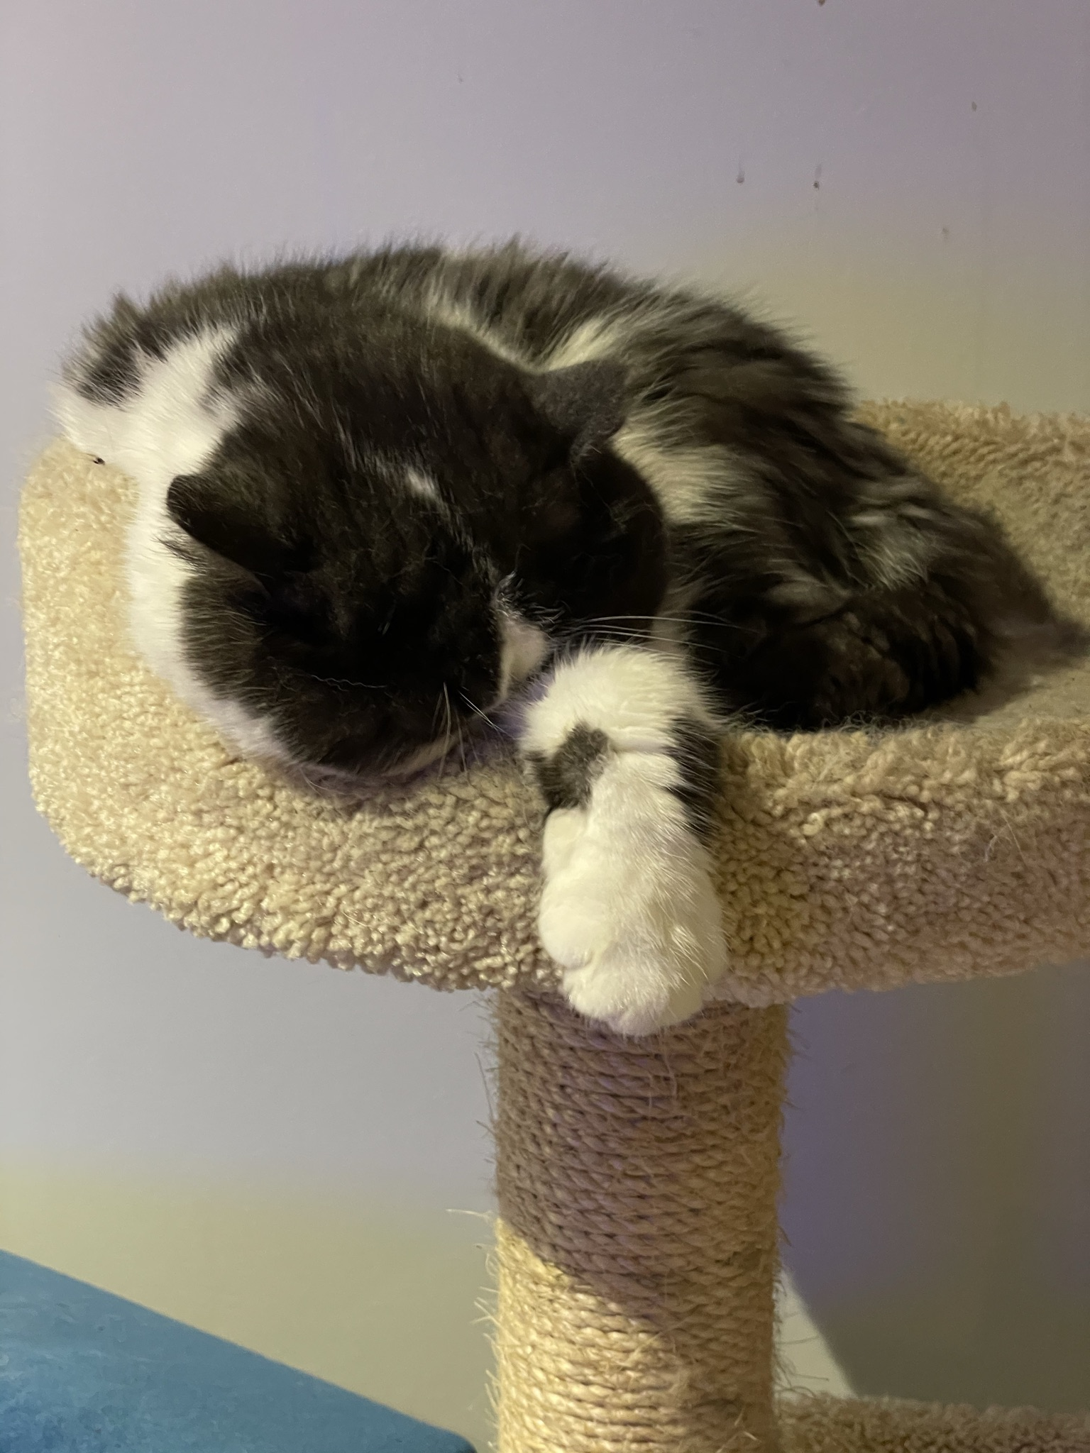
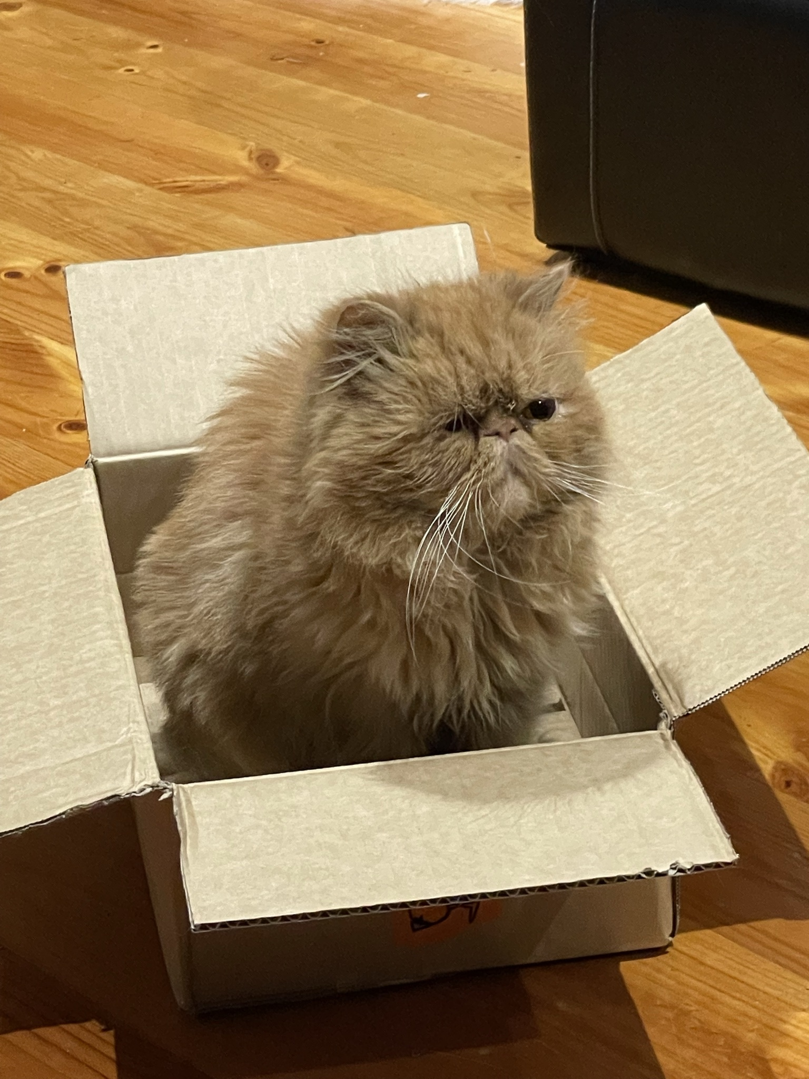
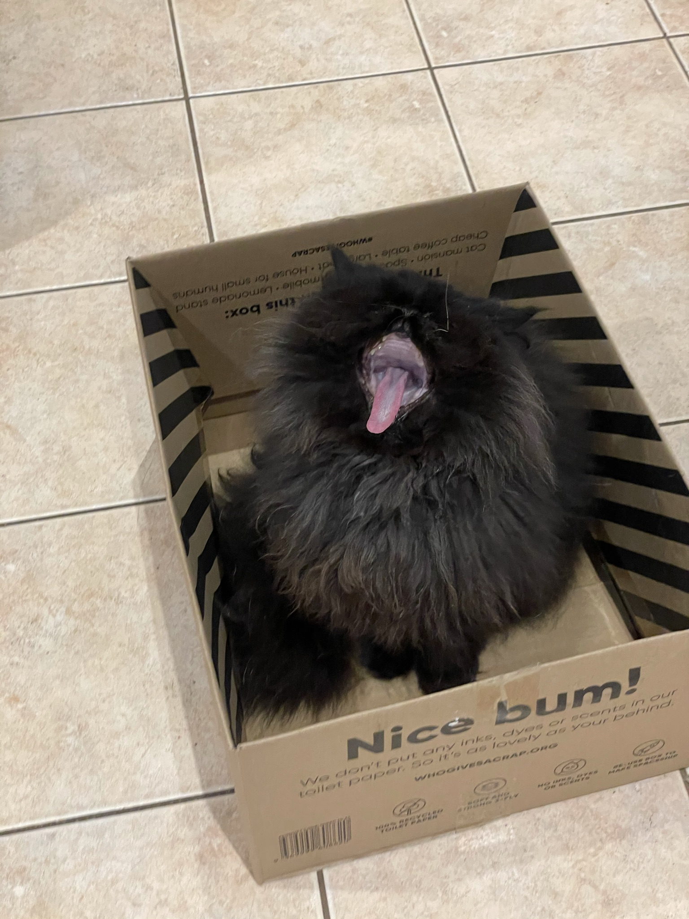

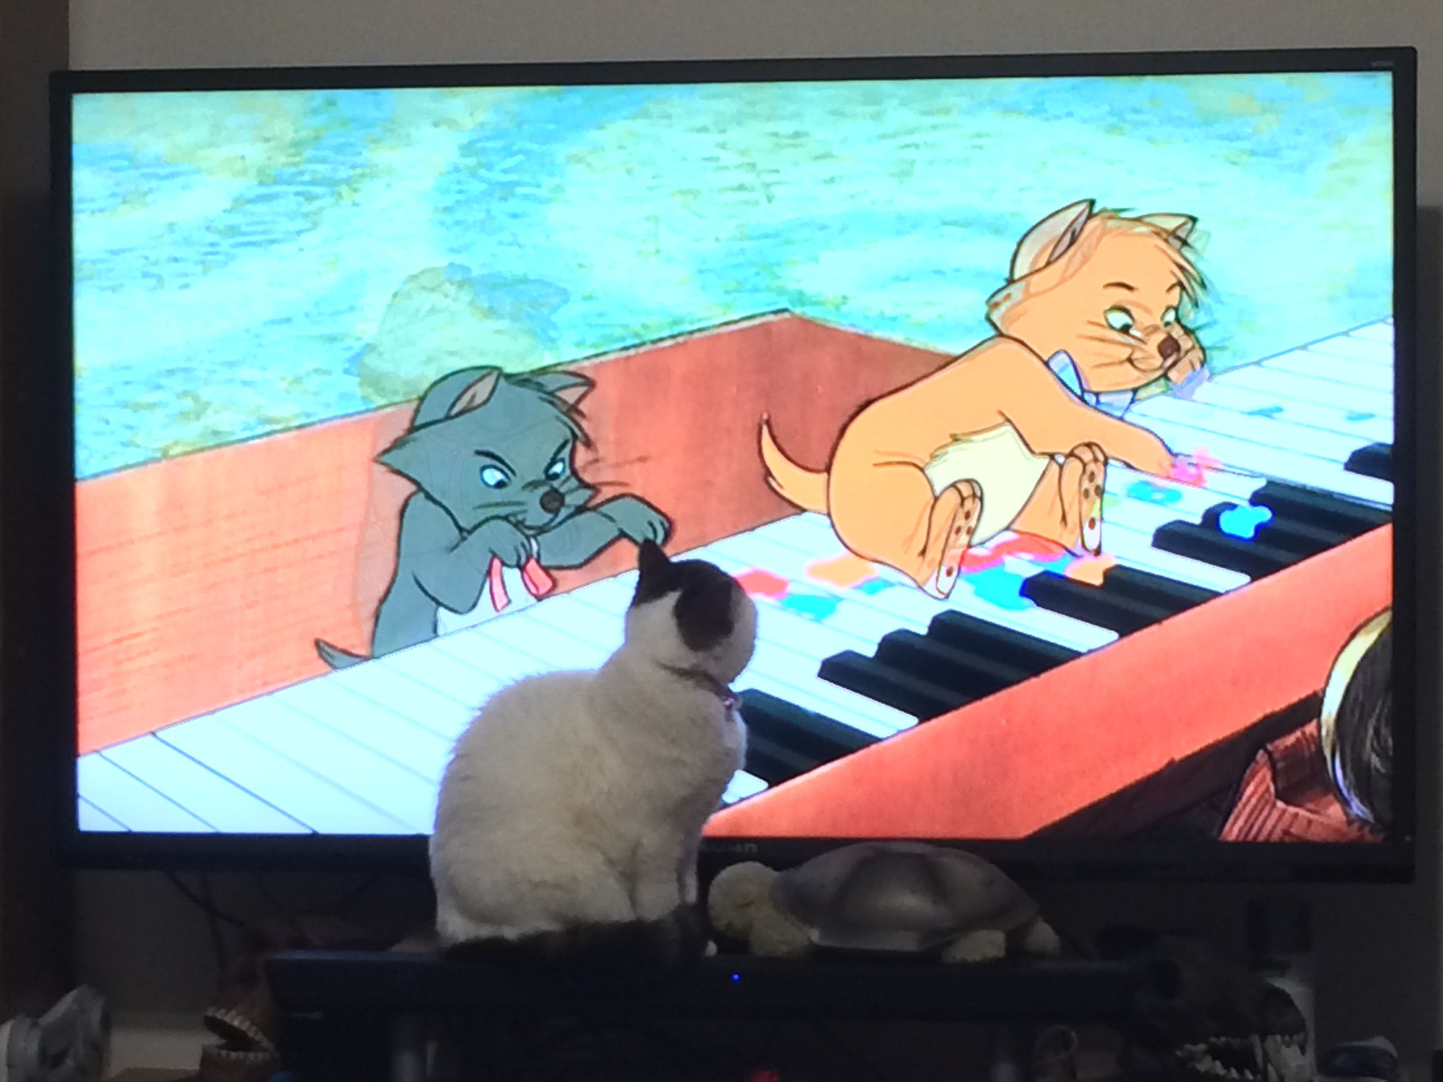
Find-A-Pet
Register
Pet Search
Login
Species
Email
Email
Breed
Password
Password

Slide 2
Find-A-Pet
Pet Search
Glinda
Breed: Persian
Age: 2
Description: Permanent Popeye squint
Microchipped – no
Desexed – yes
Available - no
Gomez
Breed: Persian
Age: 8
Description: KHAAAAAN!
Microchipped – yes
Desexed – no
Available - yes
BRUCE
Breed: Exotic
Age: 13
Description: Likes to cuddle and sleep
Microchipped – yes
Desexed – yes
Available - no
Duchess
Breed: Exotic
Age: 13
Description: An elegant lady
Microchipped – yes
Desexed – yes
Available - yes
Archie
Breed: Exotic
Age: 4
Description: Scaredy-cat
Microchipped – no
Desexed – no
Available - no

Slide 3
Find-A-Pet – Register An Animal For Adoption
Pet Details
Name
Species
Breed
Description
Microchipped
Upload picture
Desexed
Available now
Submit

Slide 4
Find-A-Pet – User Registration
Name
Contact phone
Suburb
Preferred contact
Phone
Email
Submit

